Slide 1

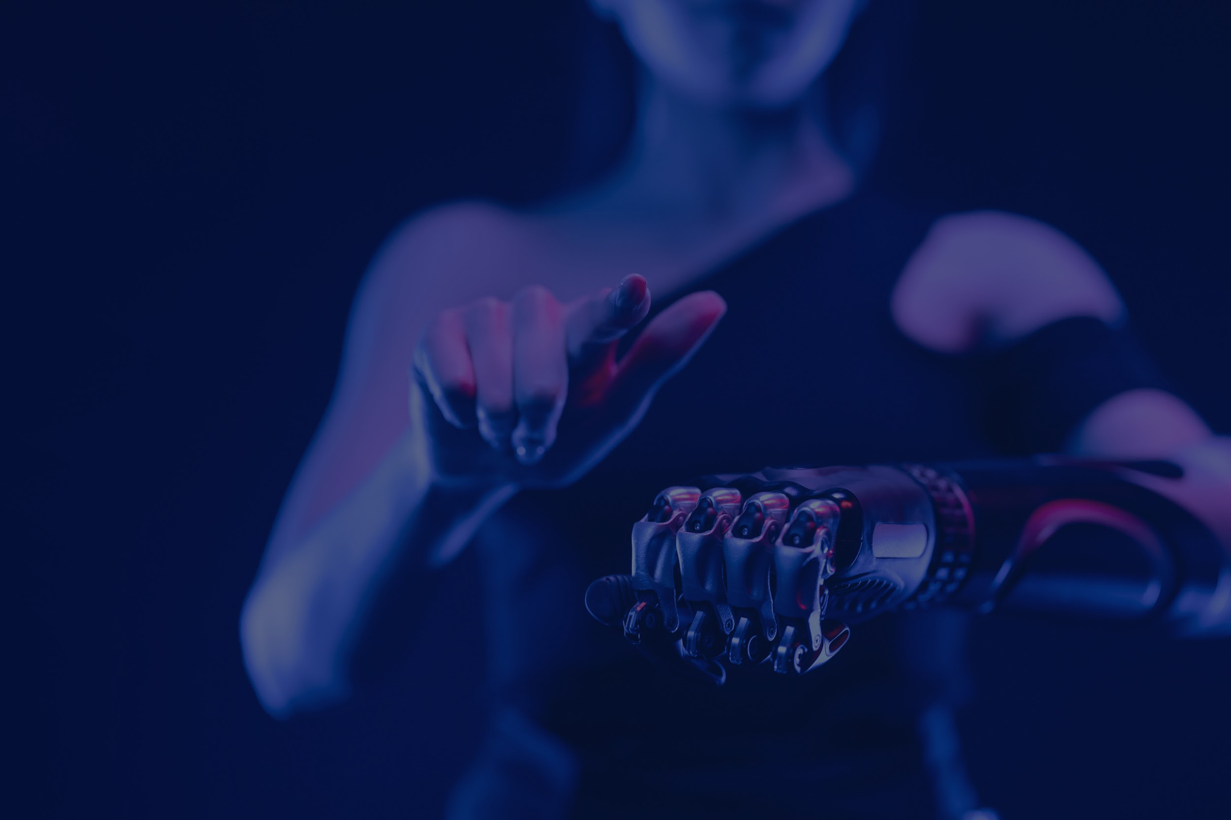
Leveraging Gen AI For
Strategic Innovation
@UST
By team Mini Coop

Slide 2
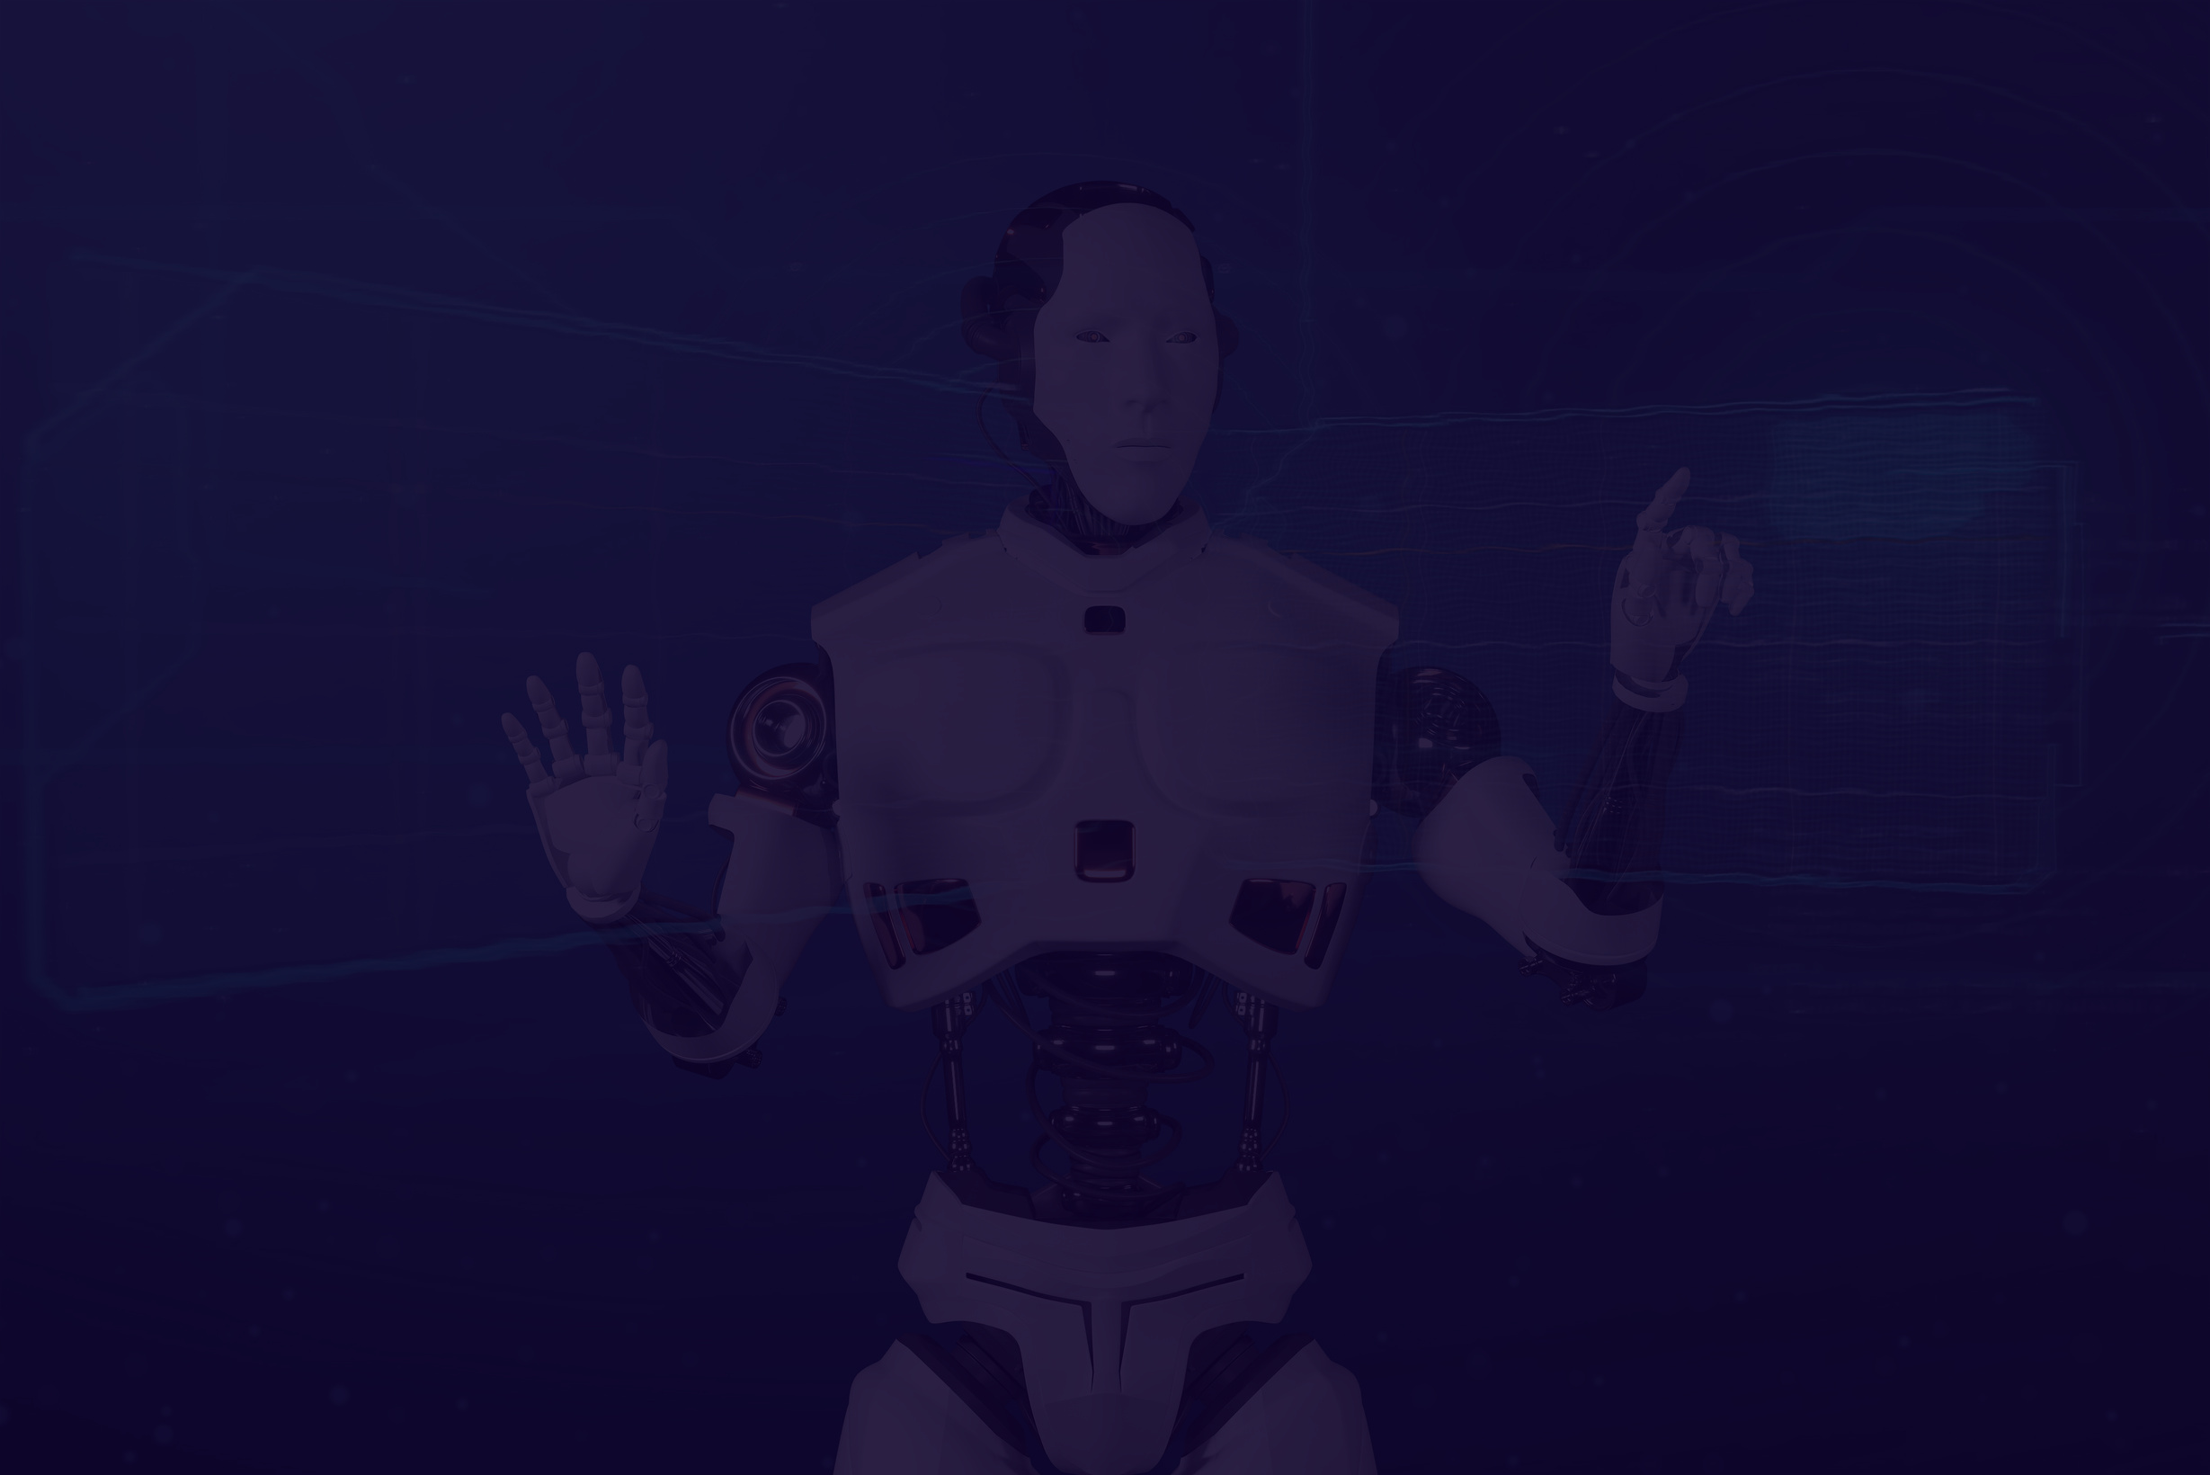
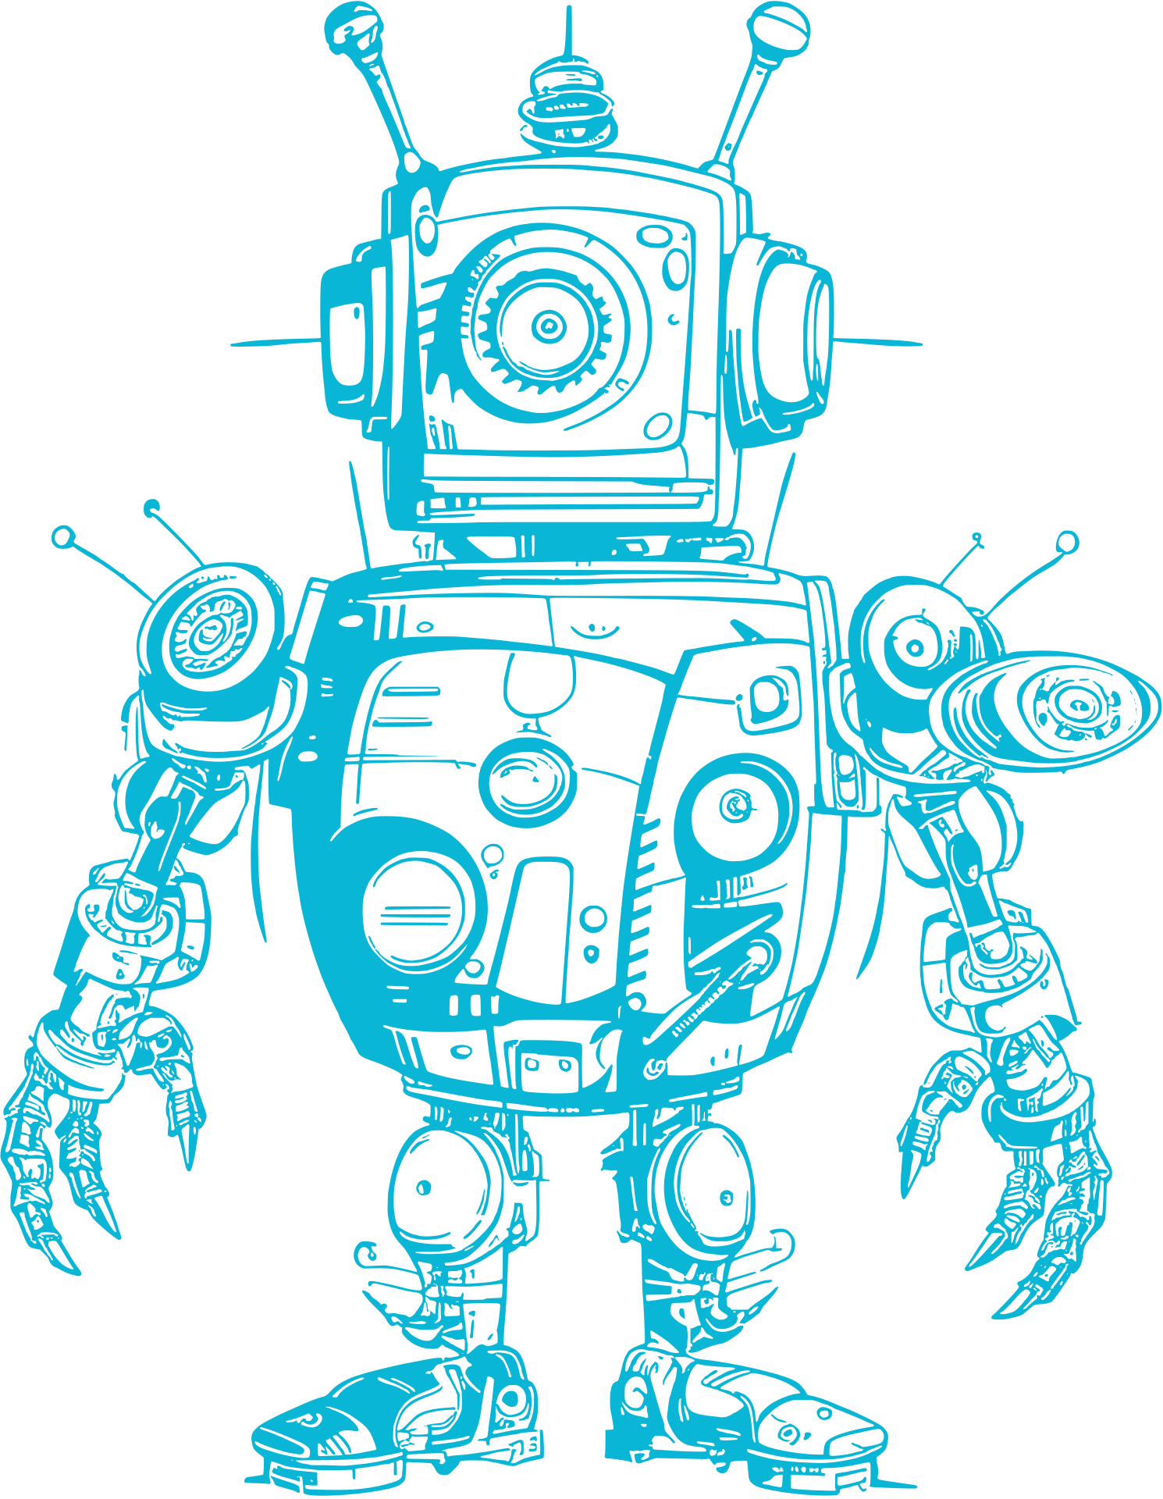

About Gen AI
Generative AI (GenAI) is a subset of artificial intelligence focused on generating new content, such as text, images, and code, by recognizing patterns in existing data and continuously training itself on it. Key applications include enhancing customer interactions through chatbots, generating marketing content, and more.

Slide 3
UST’s IsHelpDesk
Dia , the chatbot of UST/ticket assistance have some predefined tickets which have already existing standard solutions or for generating tasks.

Slide 4
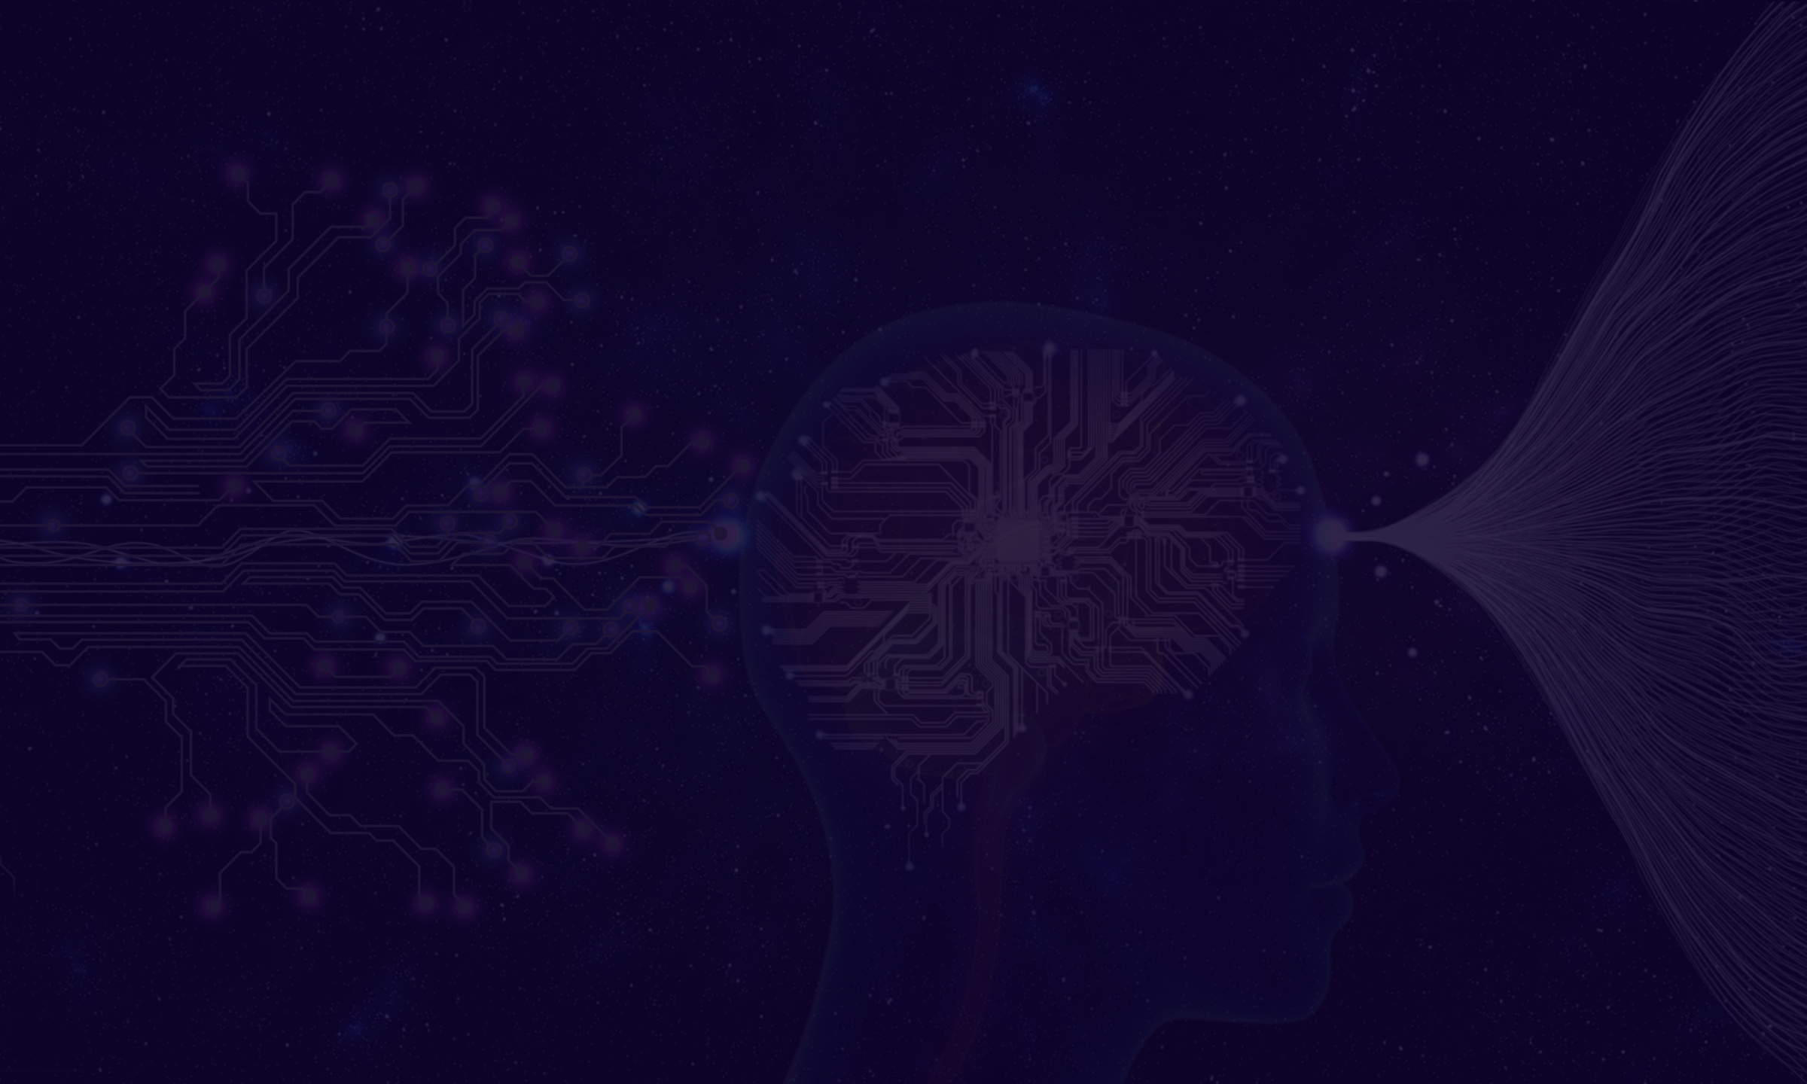
Streamlining helpdesk flow
Generative AI can streamline helpdesk operations by categorizing tasks based on priority levels:
1. Low Priority: Automated resolution using historical data and confirmation from the customer/client.
2. Medium Priority: AI-assisted solutions with minimal human intervention like approvals or conformation.
3. High Priority: Escalation to human experts for complex issues.

Slide 5
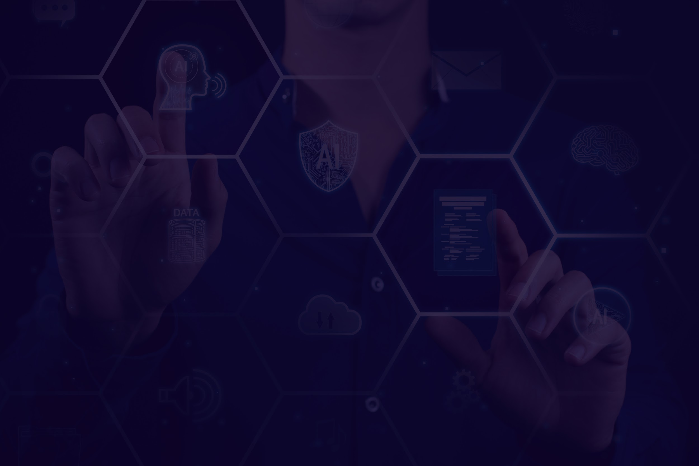


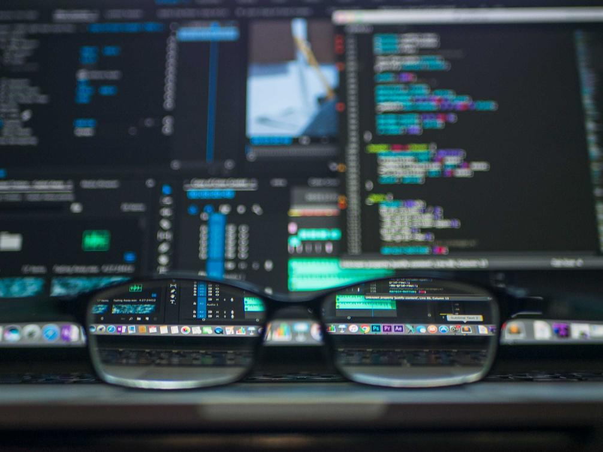
Methodology
2
3
1
Data Collection & preprocessing
Development and Testing
Deployment
Using past helpdesk chats which contains most of the issues in past years
Choosing model/domain and selecting test prompts for Testing
Deploying the trained bot after monitoring and improvements

Slide 6
Changes in isHelpDesk(UST) after this idea
As mentioned, IsHelpdesk is working with the help of human involvement continuously.
Without using the human Involvement completely, we’ll use Gen Ai to communicate and resolve the issue.
If the issue still persists or needed some human intervention, then it will assign a human to assist with us.
This can reduce the human involvement which can ultimately reduces the cost and improves Efficiency.

Slide 7
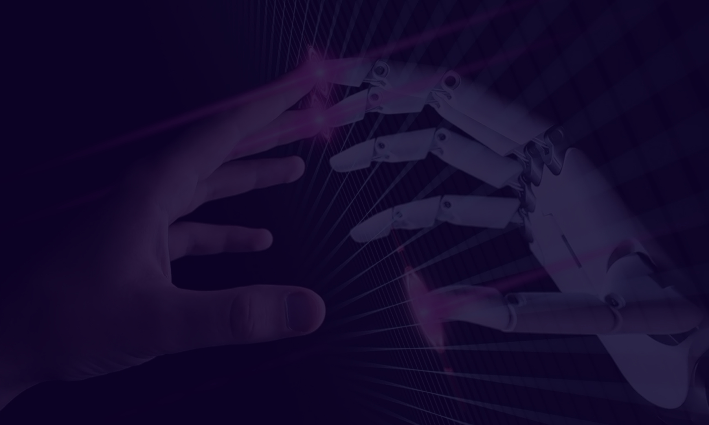
Product Development assistance using GenAI
This idea is based on a ongoing product where we continuously needs changes/Updates.
Normally in this case, we’ll come up with something based on the client needs and use a developer to develop everything.
Our idea is to make use of data from the client chats, mails and gen ai can generate some modifications or new updates based on the client chat data.
After Showcasing this to the client, we can confirm a particular update/modification.
We’ll use GenAI to generate the code for that particular modification using the existing product code and architecture. In the next step, we’ll use the prompt engineers to test and debug the code without the use of a developer.

Slide 8
Method Ideology
2
1
3
Listing out the possible developments in the required fashion
Extracting data from previous client coversations
According to the requirement , Client chooses his/her best fit
4
5
1
From the base code, the GenAI will generate the new/modified code
Prompt engineers will test and debug the final code

Slide 9
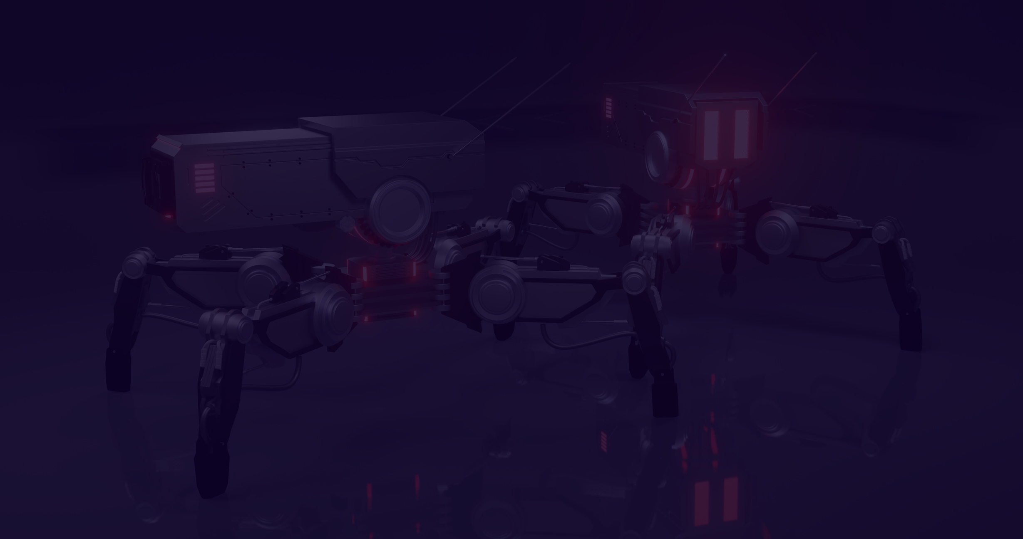
Hence, with the use of GenAI here we can produce the desired requirements of the client in a quick and efficient way.
As only modifications are needed, GenAI is capable enough of doing the job of producing the modified one from the existing one.
By using this process, we can eliminate the involvement of the developer at some extent and can produce the modified one.

Slide 10



Thank You!

